Slide 1
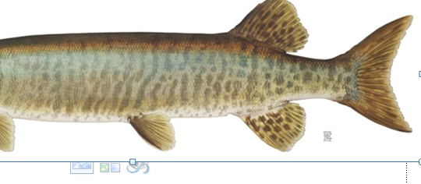
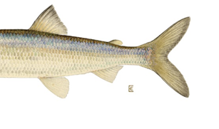
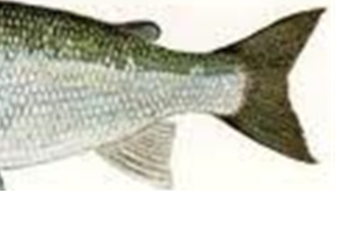
Tails of Two Cities
(LCO’s Two-Story, Story)

Slide 2
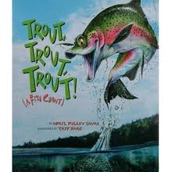
Literary (Parallels)
“It was the best of times….It was the worst of times…” – Charles Dickens from the classic novel, “Tale of Two Cities”
“We have the best of times…but will our children inherit the worst of times….” – Frank Pratt from Power Point, “Tails of Two Cities”

Slide 3
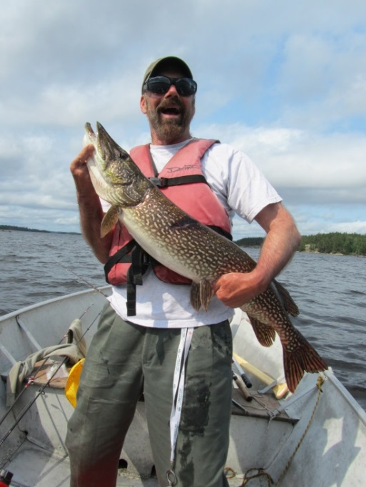
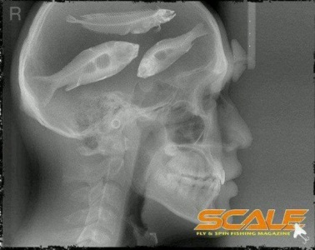
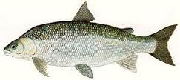
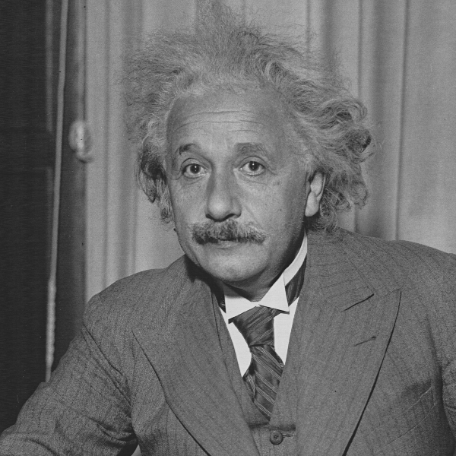
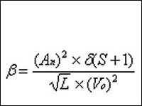
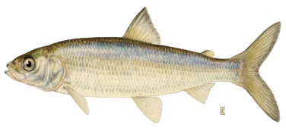

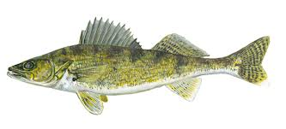
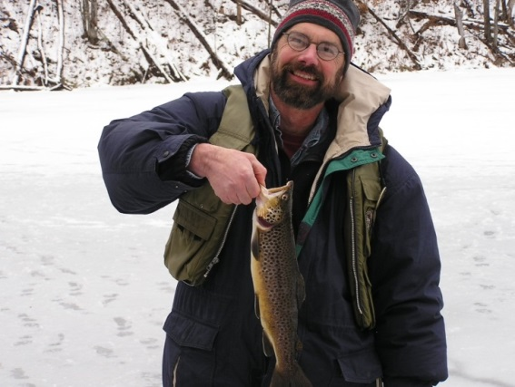
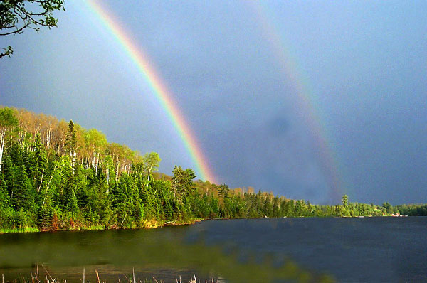
Fisheries Scientist- FRANK
Fisheries

Slide 4
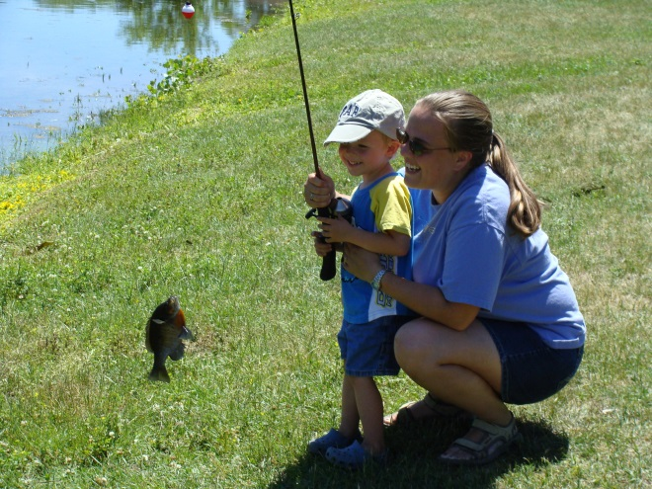





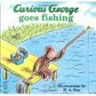
Aquatic Education
Family Fishing- Shues Pond
Fishing 101 Seniors- Tuesday AM
River Rats , Cable, July 9
Read a Fish
TODAY!

Slide 5
Loon Calls
“Limnology 101”
“Two-Story Lakes”
Study of Lakes

Slide 6
Lake +Water Rules
Water heated at surface
Cold-sinks/warm rises
Densest at 40 degrees F ( 4 C)
Deep Lakes “stratify” into 3 layers, summer
Oxygen in at surface from wind and photosynthesis
Oxygen used in depths by respiration and decay (burn)
“Thermo-chemistry” Index Lake Health

Slide 7
LCO- Peak Summer “Thermo-Chem.” Profile-
1st Story = 1-6 ft. high, @ 35-45 ft.
Depth in feet (0= surface)

Slide 8

Lake Cross-Section (Summer)
2cnd Story
1st
Basement
Warm Epilimnion
T, Oxygen
Colder “Thermocline”
(Metalimnion)
Coldest, Hypolimnion

Slide 9

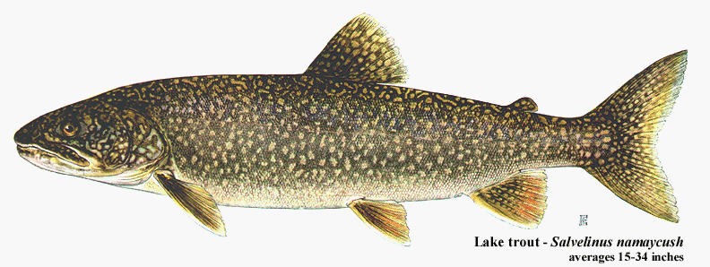
Two Story Fishery House
70+ F
2cnd Story-Warm
9 ppm
T
Ox
1st Story- Cold
O ppm
< 50 F
Basement-
Super-Cold

Slide 10
House Rules
1st Story COLD
2cnd Story HOT
Basement is SUPER-COLD, dark, low oxygen
1st Story Compresses, often very thin
Extreme Fire Danger
Exclusive Membership-Only 200 in Wi.!

Slide 11
Special House Rule
“Cold-water, Escape Hatch”
September or Late August….Maybe

Slide 12
House Utilities
Solar Heat
Solar Energy*- Photosynthesis/Predator-Prey
Energy and Oxygen Use- Burning (Death and Decay)
Basement is the Crematorium
Basement Floor = “Ashes” (sediment)
* Water clarity determines

Slide 13
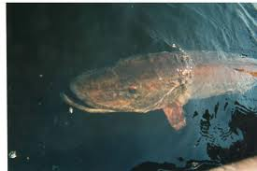
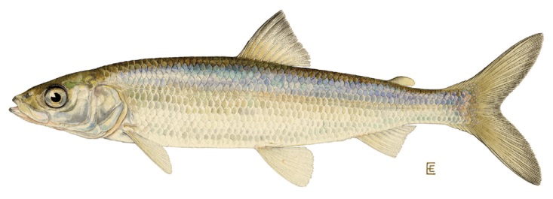
Top Predators/Top Story
Walleye, Northern, Musky, Bass- BIG!
Thank you, Mr. Cisco !

Slide 14
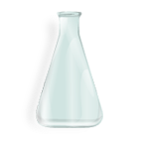
Cold-water Habitat (Most spp.*)
D.O. in ppm
T < 20 C (69 F)
> 3 ppm
Temperature C (F)
*Cisco, Smelt, most Trout species

Slide 15
Special Cold-water Habitat*
D.O. in ppm
T < 20 C (69 F)
> 3 ppm
Temperature C (F)
* Bottom-dwellers like Whitefish, Sculpins

Slide 16
Super-Special CW
Temp. < 15 C (58 F)
D.O. > 3 ppm
LCO

Slide 17
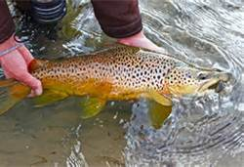
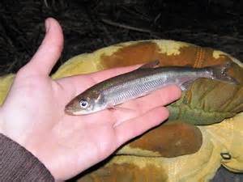
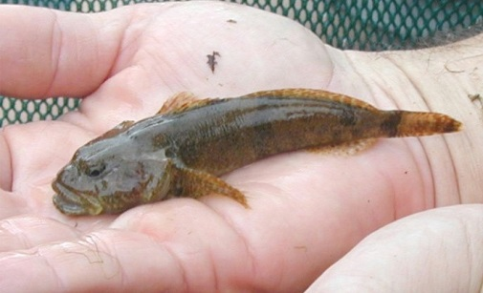
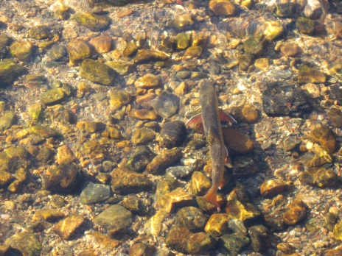
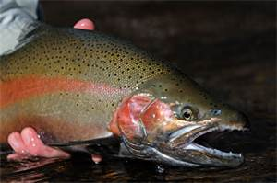
SMELT- KEEP OUT!
BROWN-STOCKED
SCULPIN- YES!
Brook-tribs
RAINBOW-STOCKED
LAKERS- NO HABITAT

Slide 18
Cisco (aka Tulibee or Lake Herring)
Cisco are suspending planktivores- found through-out the thermocline (all of 1st story, including center of the room, and not just along the walls.) Moderately abundant and smallish in LCO. Small cisco tend to be long and look very smelt-like. Size is usually an index of density. Big cisco come from small populations. Excellent forage fish for just about anything. Move upstairs to 2cnd story, in evening, to feed, and to get eaten by warmwater fish.

Slide 19
Lake
Lake Whitefish- Cold, well-oxygenated water, close to bottom. Live an long time and grow big in LCO. Not abundant. Deep-bodied. Summer habitat is already severely limited- perimeter of thermocline (walls of 1st story). More omniverous than cisco, but also capable of eating zooplankton. Considered one of the world’s best eating fish. Commercial fisheries in some waters.

Slide 20
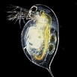
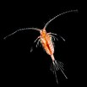

How it Works-Bottom Food Chain
Sunlight
Plants-Algae
Zooplankton
Plantivore ( Fish)

Slide 21
How it Works-Top Food Chain
Prey Predator
VERY BIG-Walleye, Musky, Northern

Slide 22
Cisco/Whitefish Habitat
35-45 ft./ 1-6 ft. layer
1st Story Thermocline

Slide 23
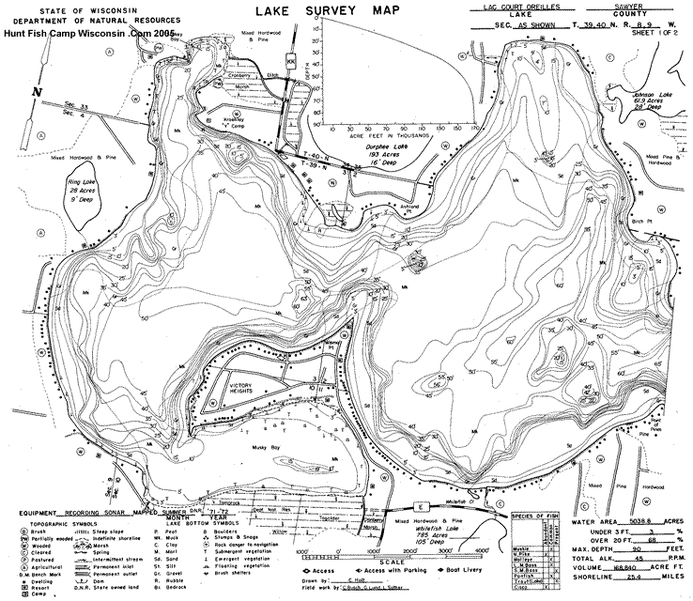

Slide 24
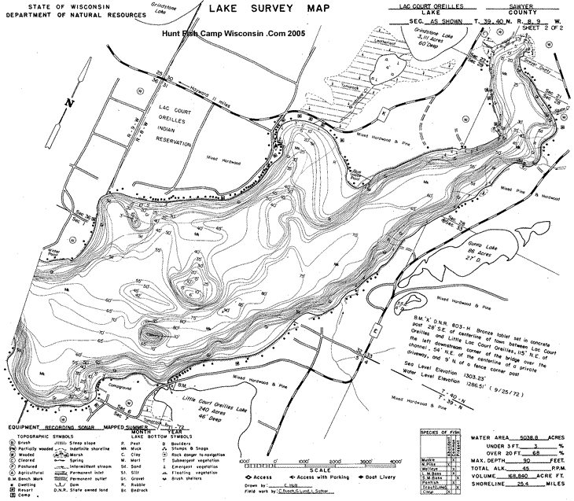

Slide 25
How Rare in State?
Wi. Lakes w/Fisheries -7000+
Two-Story Fishery ~ 200 (3%)
Self-sustaining ~ 100 (1%)
Classed ORW, no Lake Trout, but Cisco AND Whitefish- 2 (LCO and Whitefish Lakes)
“Big” (> 1000 a.) – 1 (Only LCO)
30-60% Loss from Climate Change
Absolutely Precious! (1% of 1%!!)

Slide 26
How Rare in LCO?
Cisco Habitat as low as 5 % LCO volume
Whitefish Habitat as low as 0.25%
(Musky Bay ~ 1 % total lake volume)
Sort of Rare
Extremely Rare

Slide 27
Coldwater Habitat in LCO

Slide 28
Key Factors
Temperature- Climate Change (Warm Sept.)
Oxygen- Nutrients (P)
“Heating and Burning”

Slide 29
CANARY IN THE COAL MINE
Lake Whitefish go, and……..
Cisco not far behind
Trophy fishery follows suit
4-6 ft. loss water clarity
$3-6 M/year loss Sawyer County
Children inherit a significantly degraded LCO

Slide 30
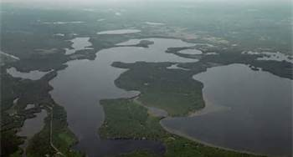
LCO Watershed
Sissabagama
69,000 acres
-80% land/20% Water
8% Sawyer County
Sand
Billy Boy
Whitefish
Little
Big LCO
Grindstone
(Osprey/Round)

Slide 31
PhosphorusThe BIG P
THE Critical limiting nutrient for plants in most lakes
Very low concentrations (ppb!)
Man induced- septic and agriculture
“Natural”-atmospheric+ run-off (increasing?)
Recycled from sediment
Two-Story “tipping point”? (12-15 ppb?)
4-6 ft. reduction in water clarity

Slide 32
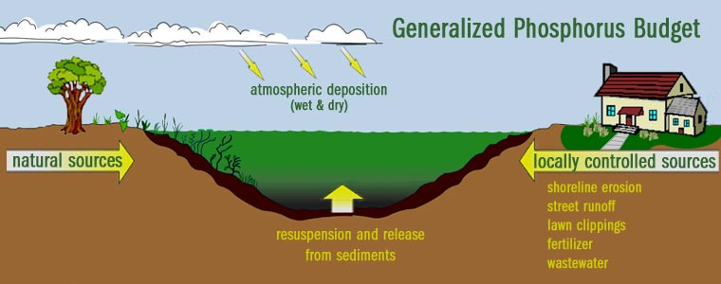
P sources to a Lake
LCO TMDL Study- Determine How Much , Sources, and What In-puts Can be Tolerated by 2015

Slide 33
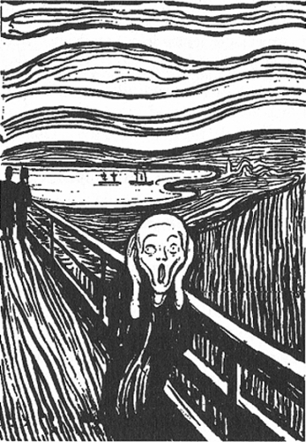

Summary-What does it Mean?
Risk Loss of Two-story Fishery
Loss of Quality Fishery and Water Quality
Future of our Children’s LCO
Need Pro-active,watershed-based,
Phosphorus Management, NOW
P

Slide 34
What to Do?
Finish TMDL
Closed Circuit Agriculture
Aggressively Limit P ( < 12 ppb)
Musky Bay
Buffer Watershed
No Smelt
Watershed Focus- Lake District?
STEWARDSHIP WITH FUTURE VIEW

